Slide 1

HUMAN VIRUSES: A CHRONOLOGICAL STUDY
Comprehensive Medical Study:Human Viruses
Exploring the Impact of Human Viruses Throughout History
Wali Ullah, Shayan Butt, Hadi
JANURAY 17, 2026

Slide 2
AGENDA
01
02
TABLE OF CONTENT
STUDY FRAMEWORK
"A STRUCTURED OVERVIEW OF ALL PRESENTATION SECTIONS, DETAILING OUR SYSTEMATIC EXAMINATION OF TEN MAJOR HUMAN VIRUSES-COVID- 19, INFLUENZA, SMALLPOX, RABIES, HIV/AIDS, HEPATITIS (A, B, C), ZIKA, EBOLA, AND YELLOW FEVER- ACROSS SEVEN KEY AREAS: VIROLOGY FUNDAMENTALS, CHRONOLOGICAL TIMELINE, TRANSMISSION ANALYSIS, ECONOMIC IMPACT, PREVENTION STRATAGIES, GLOBAL DISTRIBUTION, AND CONCLUSIVE FINDINGS"
"OUR METHODOLOGICAL APPROACH EMPLOYS CHRONOLOGICAL ANALYSIS SPANNING 1796 TO 2026, EXAMINING THESE TEN VIRUSES BY DISCOVERY DATE, WHILE INTEGRATING COMPARATIVE ASSESMENT OF TRANSMISSION MODES, FATALITY RATES, SOCIOECONOMIC IMPACTS, AND VACCINE DEVELOPMENT USING WHO/CDC DATASETS FOR SCIENTIFIC ACCURACY"

Slide 3

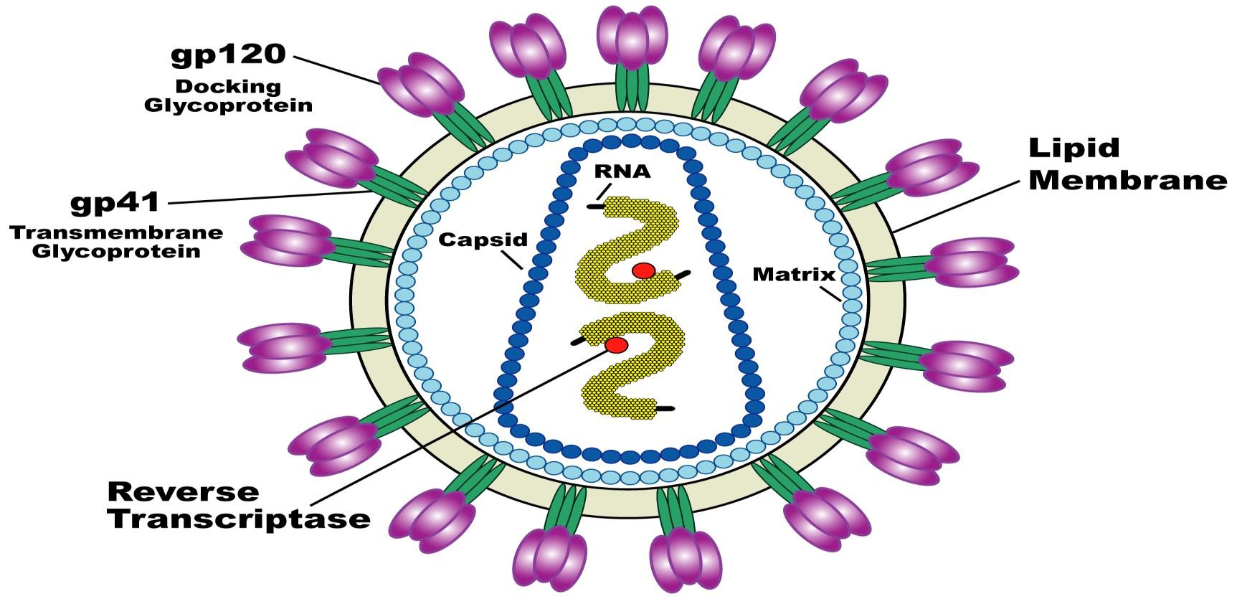
WHAT ARE VIRUSES
VIRUSES ARE EXTREMELY SMALL INFECTIOUS AGENTS MADE OF DNA OR RNA ENCLOSED IN A PROTEIN COAT, SOMETIMES WITH AN OUTER LIPID ENVELOPE. THEY LACK CELLULAR STRUCTURES AND CANNOT PERFORM METABOLISM ON THEIR OWN, SO THEY MUST ENTER A LIVING HOST CELL TO REPRODUCE. INSIDE THE HOST, VIRUSES USE THE CELL’S MACHINERY TO MAKE NEW VIRAL PARTICLES. OUTSIDE THE HOST CELL, THEY REMAIN INACTIVE. BECAUSE THEY SHOW TRAITS OF BOTH NON-LIVING MATTER OUTSIDE CELLS AND LIVING SYSTEMS INSIDE CELLS, VIRUSES ARE CONSIDERED TO EXIST AT THE BOUNDARY BETWEEN LIFE AND NON-LIFE. THEIR ABILITY TO RAPIDLY MUTATE MAKES THEM HIGHLY ADAPTABLE AND DIFFICULT TO CONTROL, AND THEY INFECT ALL FORMS OF LIFE, CAUSING MANY HUMAN DISEASES.

Slide 4
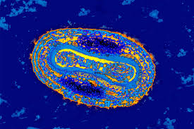
SMALLPOX
SMALLPOX (VARIOLA VIRUS) WAS A HIGHLY CONTAGIOUS AND DEADLY DISEASE CAUSED BY A DNA VIRUS OF THE POXVIRIDAE FAMILY, WITH VARIOLA MAJOR CAUSING UP TO 30% MORTALITY. IT SPREAD THROUGH RESPIRATORY DROPLETS AND CONTAMINATED OBJECTS, FOLLOWING A 7–17 DAY INCUBATION PERIOD BEFORE PRODUCING HIGH FEVER AND A DISTINCTIVE RASH THAT PROGRESSED TO PUSTULES AND LEFT PERMANENT SCARS. EDWARD JENNER DEVELOPED THE FIRST EFFECTIVE VACCINE IN 1796 USING COWPOX, LEADING TO A GLOBAL WHO VACCINATION CAMPAIGN. THE LAST NATURAL CASE OCCURRED IN 1977, AND SMALLPOX WAS DECLARED ERADICATED IN 1980, M

Slide 5
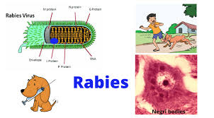
Rabies (1885) Icon
RABIES
RABIES (RABIES VIRUS) IS A DEADLY ZOONOTIC DISEASE CAUSED BY AN RNA VIRUS OF THE RHABDOVIRIDAE FAMILY. IT IS TRANSMITTED TO HUMANS THROUGH THE BITE OR SALIVA OF INFECTED ANIMALS, MOST COMMONLY DOGS. AFTER AN INCUBATION PERIOD THAT CAN LAST WEEKS TO MONTHS, SYMPTOMS INCLUDE FEVER, AGITATION, HYDROPHOBIA, AND PARALYSIS. ONCE CLINICAL SYMPTOMS APPEAR, RABIES IS ALMOST ALWAYS FATAL. HOWEVER, THE DISEASE IS PREVENTABLE THROUGH PROMPT POST-EXPOSURE VACCINATION AND ANIMAL CONTROL PROGRAMS.

Slide 6
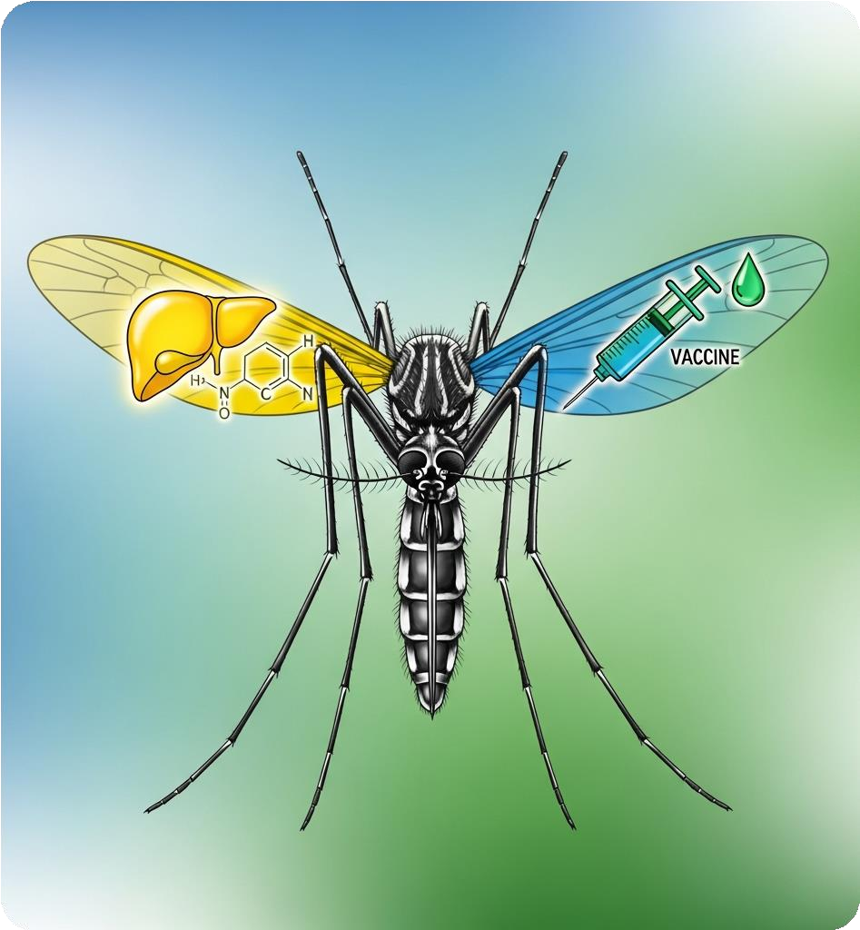
YELLOW FEVER
YELLOW FEVER (YELLOW FEVER VIRUS) IS A SERIOUS MOSQUITO-BORNE DISEASE CAUSED BY A FLAVIVIRUS. THE FIRST RECORDED OUTBREAK OCCURRED IN 1648 IN BOSTON, MASSACHUSETTS, USA, AND THE DISEASE HAS SINCE CAUSED NUMEROUS EPIDEMICS IN THE AMERICAS AND AFRICA. IT SPREADS PRIMARILY THROUGH AEDES AND HAEMAGOGUS MOSQUITOES, AND INFECTED PERSONS MAY EXPERIENCE HIGH FEVER, HEADACHE, MUSCLE PAIN, NAUSEA, JAUNDICE, BLEEDING, AND ORGAN FAILURE. THE VIRUS WAS SUCCESSFULLY ISOLATED IN 1927–1928, AND THE FIRST EFFECTIVE VACCINE WAS DEVELOPED BY MAX THEILER IN 1937, PROVIDING LONG-LASTING PROTECTION. PREVENTION RELIES ON VACCINATION, MOSQUITO CONTROL, AND PUBLIC HEALTH MEASURES, MAKING YELLOW FEVER A KEY EXAMPLE OF HOW VECTOR-BORNE DISEASES CAN BE MANAGED.

Slide 7
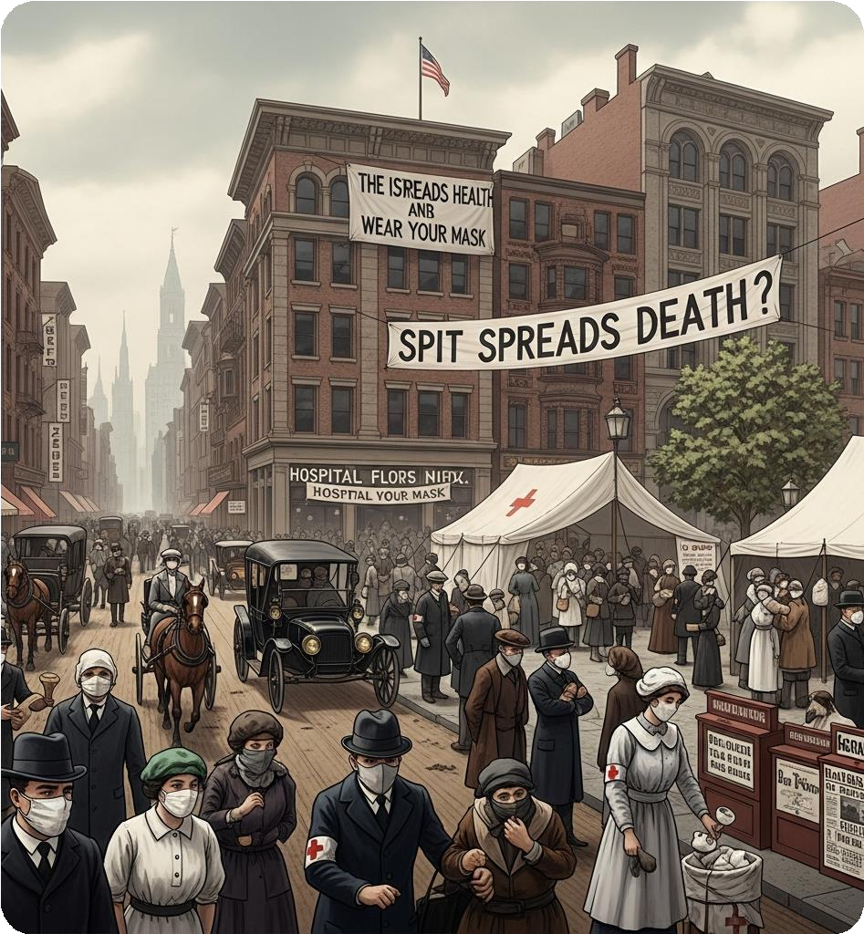
Influenza Pandemic
INFLUENZA (FLU VIRUS) IS A HIGHLY CONTAGIOUS RESPIRATORY DISEASE CAUSED BY INFLUENZA VIRUSES OF THE ORTHOMYXOVIRIDAE FAMILY, MAINLY TYPES A, B, AND C. THE DISEASE SPREADS THROUGH RESPIRATORY DROPLETS FROM COUGHING, SNEEZING, OR TALKING, AND INFECTED SURFACES CAN ALSO TRANSMIT THE VIRUS. SYMPTOMS INCLUDE FEVER, CHILLS, COUGH, SORE THROAT, MUSCLE PAIN, FATIGUE, AND HEADACHE. SEVERE CASES CAN LEAD TO PNEUMONIA AND DEATH, PARTICULARLY IN THE ELDERLY AND IMMUNOCOMPROMISED INDIVIDUALS. INFLUENZA HAS CAUSED NUMEROUS PANDEMICS, INCLUDING THE 1918 SPANISH FLU, WHICH KILLED MILLIONS WORLDWIDE. VACCINATION IS THE MOST EFFECTIVE PREVENTION, AND ANNUAL FLU SHOTS ARE RECOMMENDED DUE TO RAPID VIRAL MUTATIONS.

Slide 8
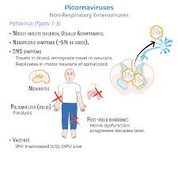
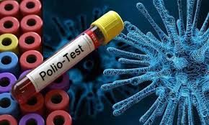
POLIO
POLIO (POLIOMYELITIS VIRUS) IS A HIGHLY CONTAGIOUS DISEASE CAUSED BY THE POLIOVIRUS, AN RNA VIRUS OF THE PICORNAVIRIDAE FAMILY. IT SPREADS PRIMARILY THROUGH FECAL-ORAL ROUTE OR CONTAMINATED WATER AND FOOD. MOST INFECTED PEOPLE HAVE MILD OR NO SYMPTOMS, BUT IN SOME CASES, THE VIRUS ATTACKS THE NERVOUS SYSTEM, LEADING TO PARALYSIS OR DEATH. THE FIRST MAJOR OUTBREAK WAS RECORDED IN THE 19TH CENTURY, AND THE VIRUS WAS ISOLATED IN 1908. SIGNIFICANT PROGRESS OCCURRED WITH THE DEVELOPMENT OF THE SALK INACTIVATED VACCINE (1955) AND THE ORAL SABIN VACCINE (1961). GLOBAL VACCINATION CAMPAIGNS HAVE REDUCED POLIO CASES BY OVER 99%, MAKING ERADICATION POSSIBLE.

Slide 9
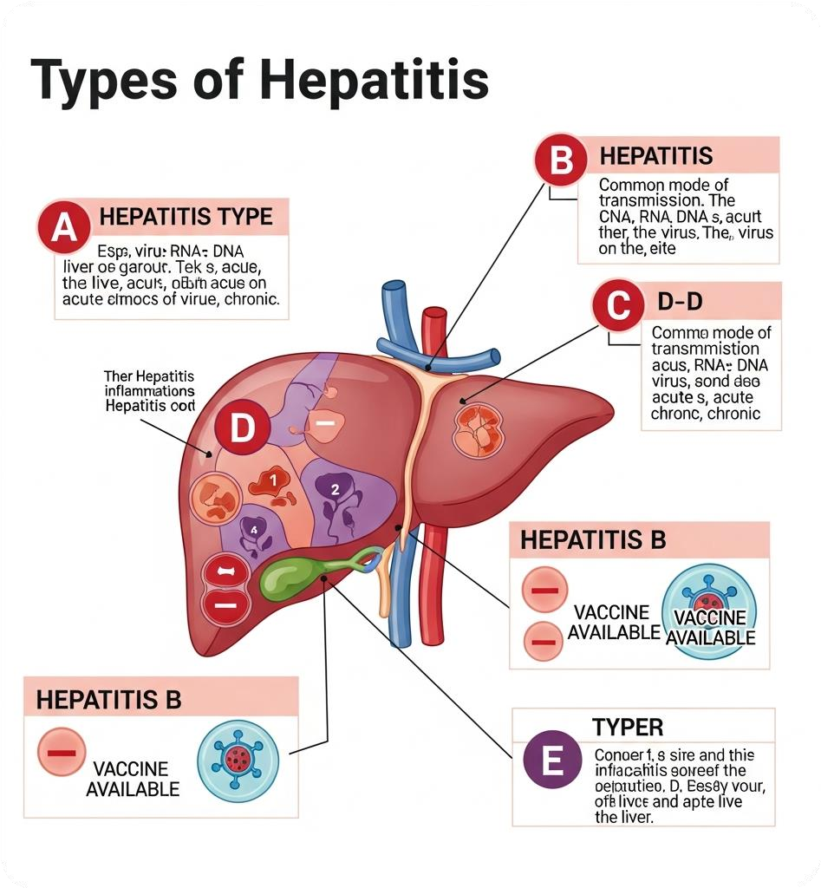
HEPATITIS
HEPATITIS IS AN INFLAMMATORY LIVER DISEASE CAUSED BY DIFFERENT VIRUSES, MAINLY HEPATITIS A, B, C, D, AND E VIRUSES. IT CAN SPREAD THROUGH CONTAMINATED FOOD OR WATER (HEPATITIS A AND E), BLOOD OR BODY FLUIDS (HEPATITIS B, C, D), AND UNSAFE MEDICAL PRACTICES. SYMPTOMS INCLUDE JAUNDICE, FATIGUE, ABDOMINAL PAIN, LOSS OF APPETITE, NAUSEA, AND FEVER. SEVERE CASES MAY LEAD TO LIVER FAILURE OR CANCER. VACCINES ARE AVAILABLE FOR HEPATITIS A AND B, AND PREVENTION RELIES ON SAFE HYGIENE, SCREENING BLOOD DONORS, AND VACCINATION. HEPATITIS REMAINS A MAJOR GLOBAL HEALTH CONCERN, AFFECTING MILLIONS WORLDWIDE EACH YEAR.

Slide 10

HIV/ AIDS
HIV/AIDS (HUMAN IMMUNODEFICIENCY VIRUS / ACQUIRED IMMUNE DEFICIENCY SYNDROME) IS A CHRONIC, LIFE-THREATENING DISEASE CAUSED BY HIV, A RETROVIRUS THAT ATTACKS THE IMMUNE SYSTEM, PARTICULARLY CD4+ T-CELLS. IT SPREADS THROUGH BLOOD, SEXUAL CONTACT, SHARING NEEDLES, AND FROM MOTHER TO CHILD DURING BIRTH OR BREASTFEEDING. INITIAL INFECTION MAY CAUSE FLU-LIKE SYMPTOMS, BUT OVER TIME, THE IMMUNE SYSTEM WEAKENS, LEADING TO AIDS, WHICH MAKES INDIVIDUALS SUSCEPTIBLE TO OPPORTUNISTIC INFECTIONS AND CANCERS. HIV WAS FIRST IDENTIFIED IN 1983, AND SINCE THEN GLOBAL EFFORTS HAVE LED TO ANTIRETROVIRAL THERAPIES (ART) THAT CONTROL THE VIRUS AND PROLONG LIFE. PREVENTION INCLUDES SAFE SEX, SCREENING, AWARENESS, AND EARLY TREATMENT.

Slide 11

Ebola
EBOLA VIRUS DISEASE (EVD) IS A SEVERE, OFTEN FATAL ILLNESS CAUSED BY THE EBOLAVIRUS, A FILOVIRUS. IT IS TRANSMITTED TO HUMANS FROM INFECTED ANIMALS (LIKE FRUIT BATS OR MONKEYS) AND SPREADS BETWEEN HUMANS THROUGH DIRECT CONTACT WITH BLOOD, BODY FLUIDS, OR CONTAMINATED OBJECTS. SYMPTOMS INCLUDE SUDDEN FEVER, SEVERE HEADACHE, MUSCLE PAIN, WEAKNESS, VOMITING, DIARRHEA, BLEEDING, AND ORGAN FAILURE. THE VIRUS WAS FIRST IDENTIFIED IN 1976 IN CONGO AND SUDAN, AND MAJOR OUTBREAKS HAVE OCCURRED SINCE, INCLUDING THE 2014–2016 WEST AFRICA EPIDEMIC. PREVENTION INVOLVES ISOLATION, PROTECTIVE EQUIPMENT, SAFE BURIAL PRACTICES, AND VACCINATION.

Slide 12
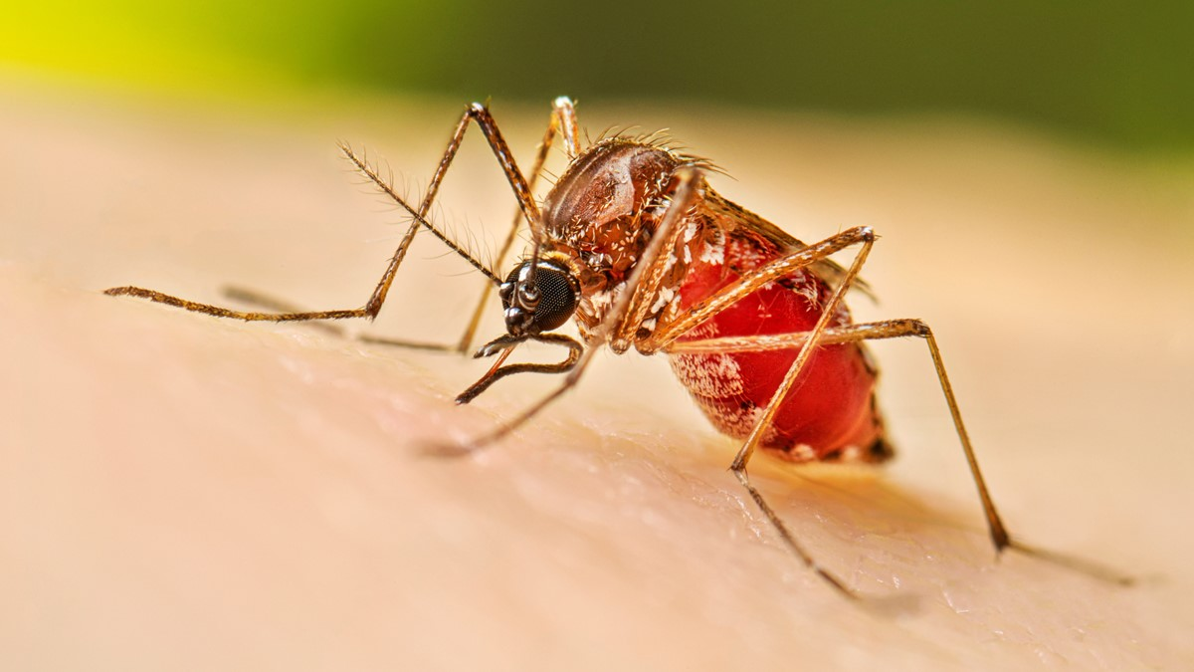
Dengue
DENGUE FEVER (DENGUE VIRUS) IS A MOSQUITO-BORNE DISEASE CAUSED BY A FLAVIVIRUS WITH FOUR DISTINCT SEROTYPES (DENV-1 TO DENV-4). IT IS TRANSMITTED TO HUMANS MAINLY BY AEDES AEGYPTI AND AEDES ALBOPICTUS MOSQUITOES. INFECTION CAN CAUSE HIGH FEVER, SEVERE HEADACHE, JOINT AND MUSCLE PAIN, RASH, NAUSEA, AND IN SEVERE CASES, HEMORRHAGIC FEVER OR SHOCK. THE VIRUS WAS FIRST IDENTIFIED IN 1943–1945, AND OUTBREAKS HAVE SINCE OCCURRED WORLDWIDE, ESPECIALLY IN TROPICAL AND SUBTROPICAL REGIONS. PREVENTION RELIES ON MOSQUITO CONTROL, ELIMINATION OF BREEDING SITES, AND PERSONAL PROTECTION, WITH VACCINES AVAILABLE IN SOME COUNTRIES.

Slide 13
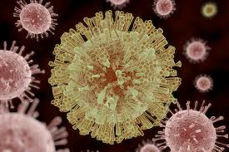

Zika
ZIKA VIRUS DISEASE (ZIKA VIRUS) IS A MOSQUITO-BORNE INFECTION CAUSED BY A FLAVIVIRUS, PRIMARILY TRANSMITTED BY AEDES AEGYPTI AND AEDES ALBOPICTUS MOSQUITOES. IT CAN ALSO SPREAD THROUGH SEXUAL CONTACT, BLOOD TRANSFUSION, AND FROM MOTHER TO FETUS. INFECTION IS OFTEN MILD, CAUSING FEVER, RASH, JOINT PAIN, HEADACHE, AND CONJUNCTIVITIS, BUT DURING PREGNANCY, IT CAN LEAD TO CONGENITAL BIRTH DEFECTS, INCLUDING MICROCEPHALY. THE VIRUS WAS FIRST IDENTIFIED IN 1947 IN THE ZIKA FOREST OF UGANDA, AND OUTBREAKS HAVE OCCURRED IN AFRICA, ASIA, THE PACIFIC, AND THE AMERICAS. PREVENTION INCLUDES MOSQUITO CONTROL, PERSONAL PROTECTION, AND SAFE SEX PRACTICES.

Slide 14

COVID-19
COVID-19 (CORONAVIRUS DISEASE 2019) IS A HIGHLY CONTAGIOUS RESPIRATORY DISEASE CAUSED BY SARS-COV-2, A NOVEL RNA CORONAVIRUS FIRST IDENTIFIED IN DECEMBER 2019 IN WUHAN, CHINA. IT SPREADS MAINLY THROUGH RESPIRATORY DROPLETS, AEROSOLS, AND CONTAMINATED SURFACES, AND CAN CAUSE FEVER, COUGH, SHORTNESS OF BREATH, FATIGUE, LOSS OF TASTE OR SMELL, AND IN SEVERE CASES, PNEUMONIA, ORGAN FAILURE, OR DEATH. COVID-19 LED TO A GLOBAL PANDEMIC DECLARED BY THE WHO IN MARCH 2020, AFFECTING MILLIONS WORLDWIDE. PREVENTION INCLUDES MASK WEARING, SOCIAL DISTANCING, VACCINATION, HAND HYGIENE, AND AWARENESS OF PUBLIC HEALTH GUIDELINES.

Slide 15
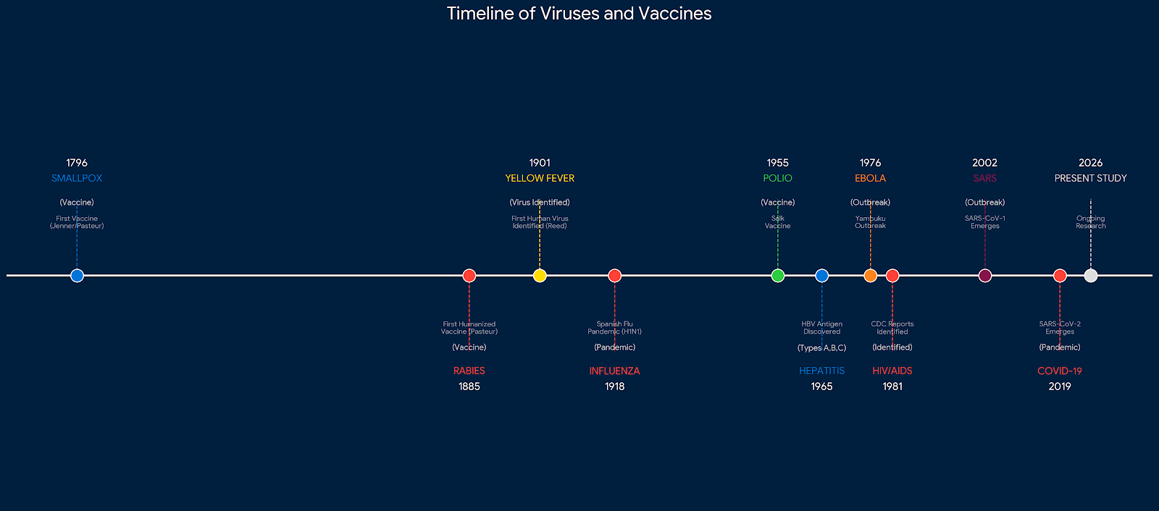
CHRONOLOGICAL VIRUS TIMELINE: 1796-2026
THE TIMELINE OF HUMAN VIRUSES FROM 1796 TO 2026 SHOWS HOW DISCOVERIES, VACCINES, AND OUTBREAKS HAVE SHAPED MEDICAL HISTORY. IT STARTS WITH SMALLPOX VACCINE IN 1796, FOLLOWED BY RABIES VACCINE IN 1885 AND YELLOW FEVER VACCINE IN 1937. THE 20TH CENTURY SAW INFLUENZA PANDEMICS AND POLIO VACCINES, WHILE LATER YEARS INCLUDED THE IDENTIFICATION OF HIV/AIDS, EBOLA, ZIKA, AND COVID-19. GLOBAL EFFORTS IN VACCINATION, SURVEILLANCE, AND PREVENTION HAVE REDUCED MANY VIRAL DISEASES AND IMPROVED PUBLIC HEALTH WORLDWIDE. THIS TIMELINE HIGHLIGHTS THE PROGRESS OF VIROLOGY AND THE IMPORTANCE OF VACCINES IN PROTECTING HUMANITY.

Slide 16
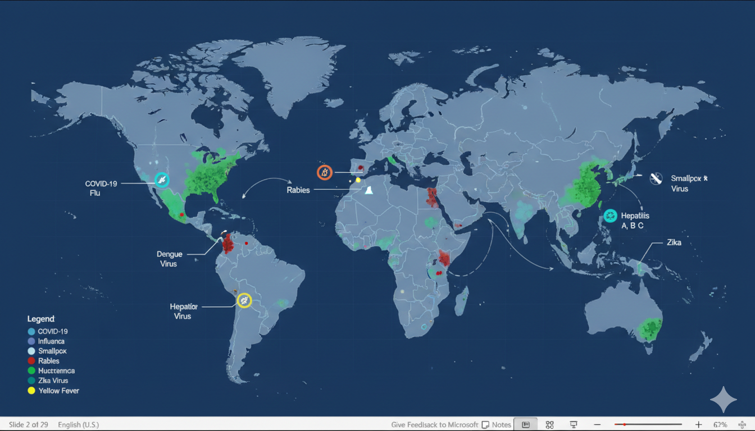
Global Distribution Map

Slide 17
Economic Impact of Major Outbreaks
Outbreak
Financial Cost (in billion $)
COVID-19
3,800
Ebola
53
SARS
40
Zika
8
H1N1
80

Slide 18
VIRUS H
15%
VIRUS I
6%
VIRUS J
12%

Slide 19
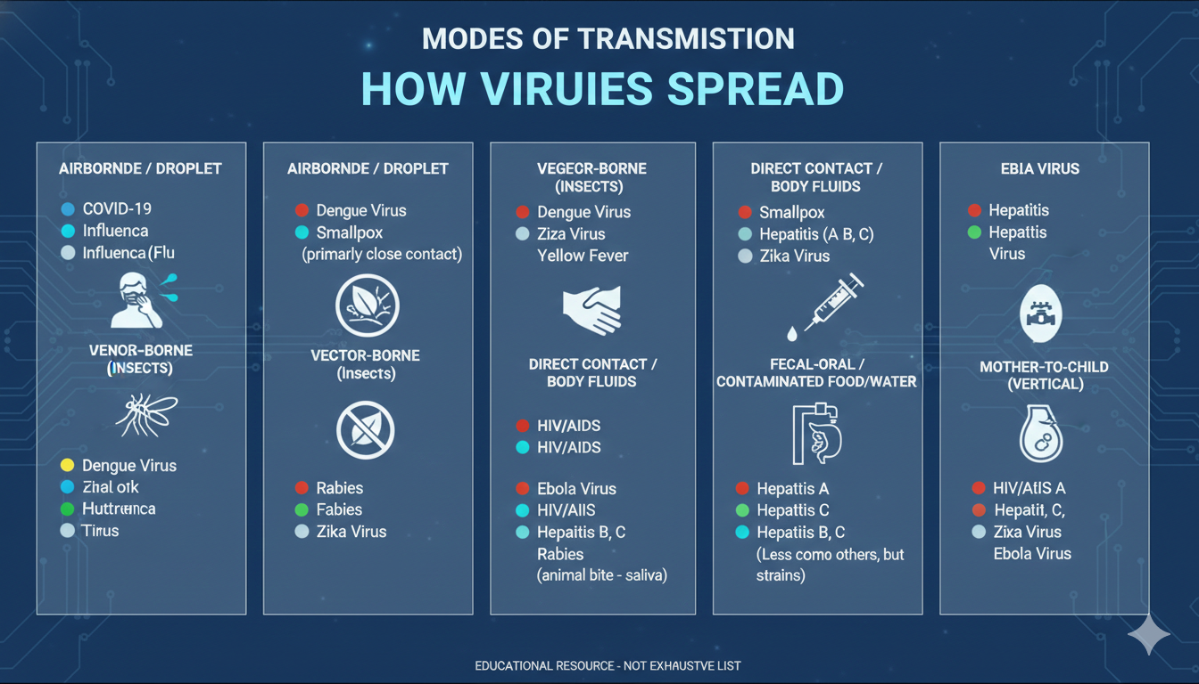
Modes of Transmission

Slide 20
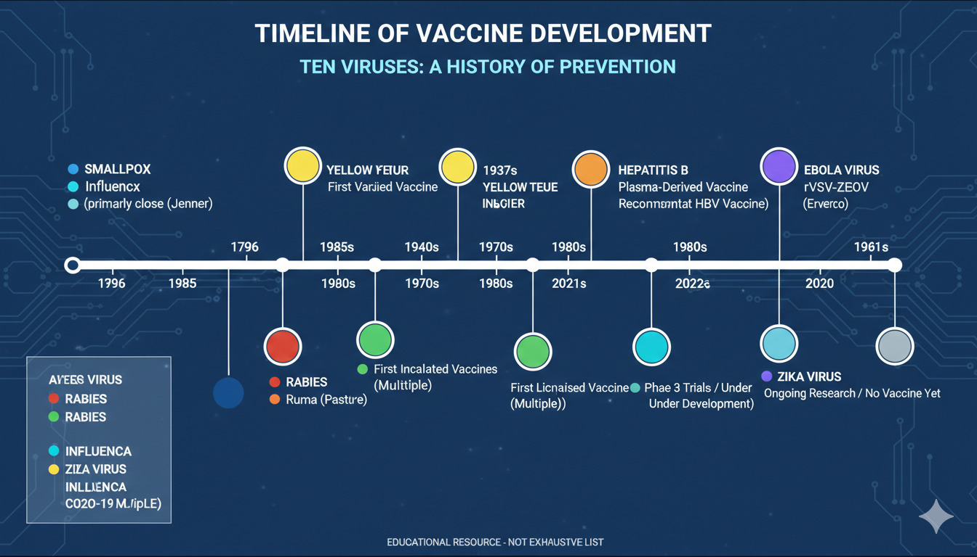

Slide 21
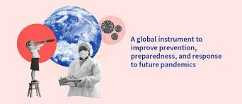
FUTURE VIRAL THREATS & PANDEMIC PREPAREDNESS
WHILE WE HAVE MADE SIGNIFICANT PROGRESS AGAINST KNOWN VIRUSES, EMERGING THREATS AND ZOONOTIC SPILLOVERS CONTINUE TO CHALLENGE GLOBAL HEALTH SECURITY. CLIMATE CHANGE, URBANIZATION, AND INCREASED GLOBAL TRAVEL ACCELERATE VIRAL EVOLUTION AND SPREAD. FUTURE PREPAREDNESS REQUIRES ENHANCED SURVEILLANCE, RAPID VACCINE PLATFORMS, AND STRENGTHENED HEALTHCARE INFRASTRUCTURE TO MITIGATE NEXT-GENERATION PANDEMICS.

Slide 22
KEY STATICS
SMALLPOX: CAUSED OVER 300 MILLION DEATHS IN THE 20TH CENTURY; ONLY HUMAN DISEASE ERADICATED (1980).
RABIES: NEARLY 59,000 DEATHS ANNUALLY, MOSTLY IN ASIA AND AFRICA; FATAL WITHOUT VACCINE POST-EXPOSURE.
YELLOW FEVER: CAUSES 30,000 DEATHS ANNUALLY; VACCINATION HAS REDUCED OUTBREAKS.
INFLUENZA: RESPONSIBLE FOR 250,000–500,000 DEATHS ANNUALLY; 1918 SPANISH FLU KILLED MILLIONS WORLDWIDE.
INFLUENZA: RESPONSIBLE FOR 250,000–500,000 DEATHS ANNUALLY; 1918 SPANISH FLU KILLED MILLIONS WORLDWIDE.
HEPATITIS B & C: AFFECT OVER 300 MILLION PEOPLE GLOBALLY; LEADING TO LIVER FAILURE AND CANCER.

Slide 23
HIV/AIDS: OVER 40 MILLION DEATHS SINCE 1980s; 38 MILLION PEOPLE LIVING WITH HIV IN 2025. EBOLA: CASE FATALITY RATES UP TO 90% IN OUTBREAKS; MAJOR EPIDEMIC 2014–2016 WEST AFRICA. DENGUE: 50–100 MILLION INFECTIONS ANNUALLY; SEVERE FORMS CAUSE HEMORRHAGIC FEVER. ZIKA: LINKED TO CONGENITAL BIRTH DEFECTS DURING 2015–2016 OUTBREAKS. COVID-19: OVER 6.9 MILLION REPORTED DEATHS (2026); GLOBAL PANDEMIC WITH MASS VACCINATION EFFORTS.

Slide 24

VISUAL CREDITS & SOURCE ATTRIBUTION
WORLD HEALTH ORGANIZATION (WHO)
GLOBAL HEALTH OBSERVATORY DATA
PANDEMIC REPORTS & STATISTICS
VACCINE EFFICACY STUDIES
OUTBREAK SITUATION REPORTS
🌐 https://www.who.int
CENTERS FOR DISEASE CONTROL (CDC)
MORBIDITY & MORTALITY WEEKLY REPORTS
VACCINE INFORMATION STATEMENTS
TRAVEL HEALTH NOTICES
NATIONAL NOTIFIABLE DISEASES DATA
🌐 https://www.cdc.gov

Slide 25
NATIONAL INSTITUTES OF HEALTH (NIH)
PUBMED RESEARCH DATABASE
CLINICAL TRIAL RESULTS
GENOMIC SEQUENCING DATA
TREATMENT GUIDELINES
🌐 https://www.nih.gov
JOHNS HOPKINS UNIVERSITY
COVID-19 DASHBOARD & ANALYTICS
CORONAVIRUS RESOURCE CENTER
GLOBAL HEALTH SECURITY INDEX
🌐 https://www.jhu.edu
🌐 COVID DASHBOARD
GOOGLE RESEARCH & DATASETS
GOOGLE HEALTH AI RESEARCH
GOOGLE SCHOLAR PUBLICATIONS
GOOGLE TRENDS EPIDEMIOLOGICAL DATA
PUBLIC DATASET PROGRAM
🌐 https://research.google
🌐 https://scholar.google.com

Slide 26
THANK YOU
ADVANCING KNOWLEDGE FOR A SAFER, HEALTHIER WORLD
THANK YOU FOR YOUR TIME AND ATTENTION
PRESENTATION CREATED BY:
WALI ULLAH
PROJECT LEAD & RESEARCH COORDINATOR
SHAYAN BUTT
DATA ANALYSIS & STATISTICAL MODELING
HADI
VISUAL DESIGN & PRESENTATION DEVELOPMENT

